Slide 1

UAS Paradrogue Research and Development

Slide 2
By Forrest Mobley
Aerospace Engineering
mobleyf@my.erau.edu
Mentored by Dr. Hayashibara
College of Engineering

Slide 3
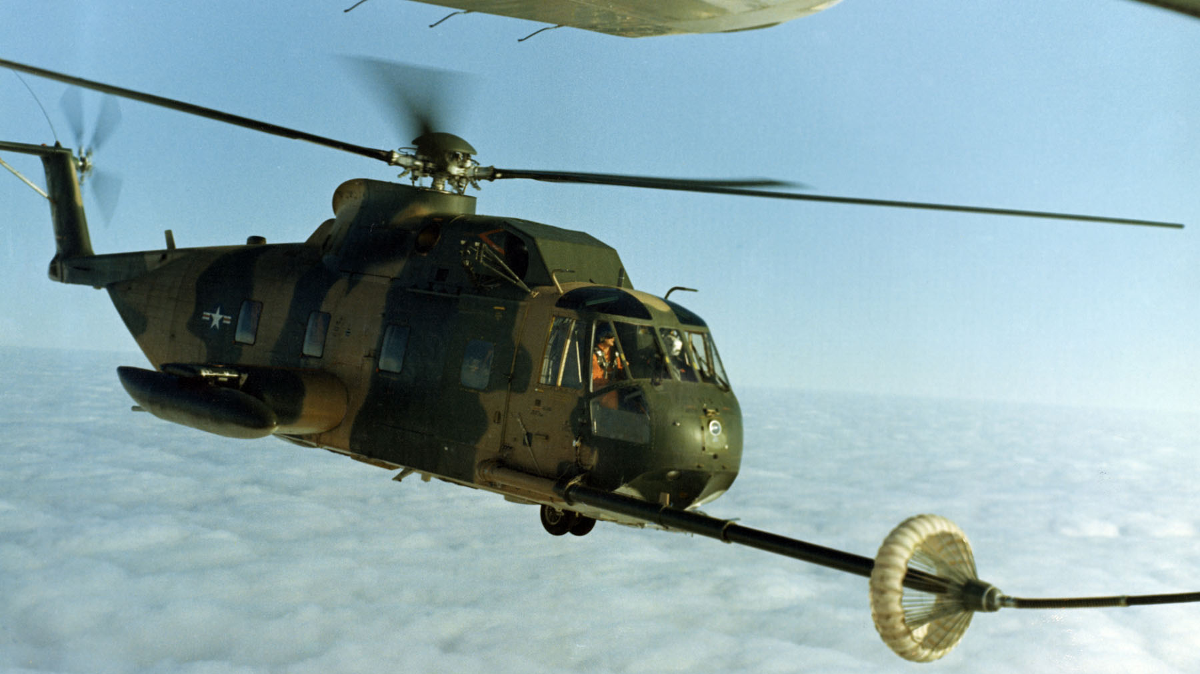
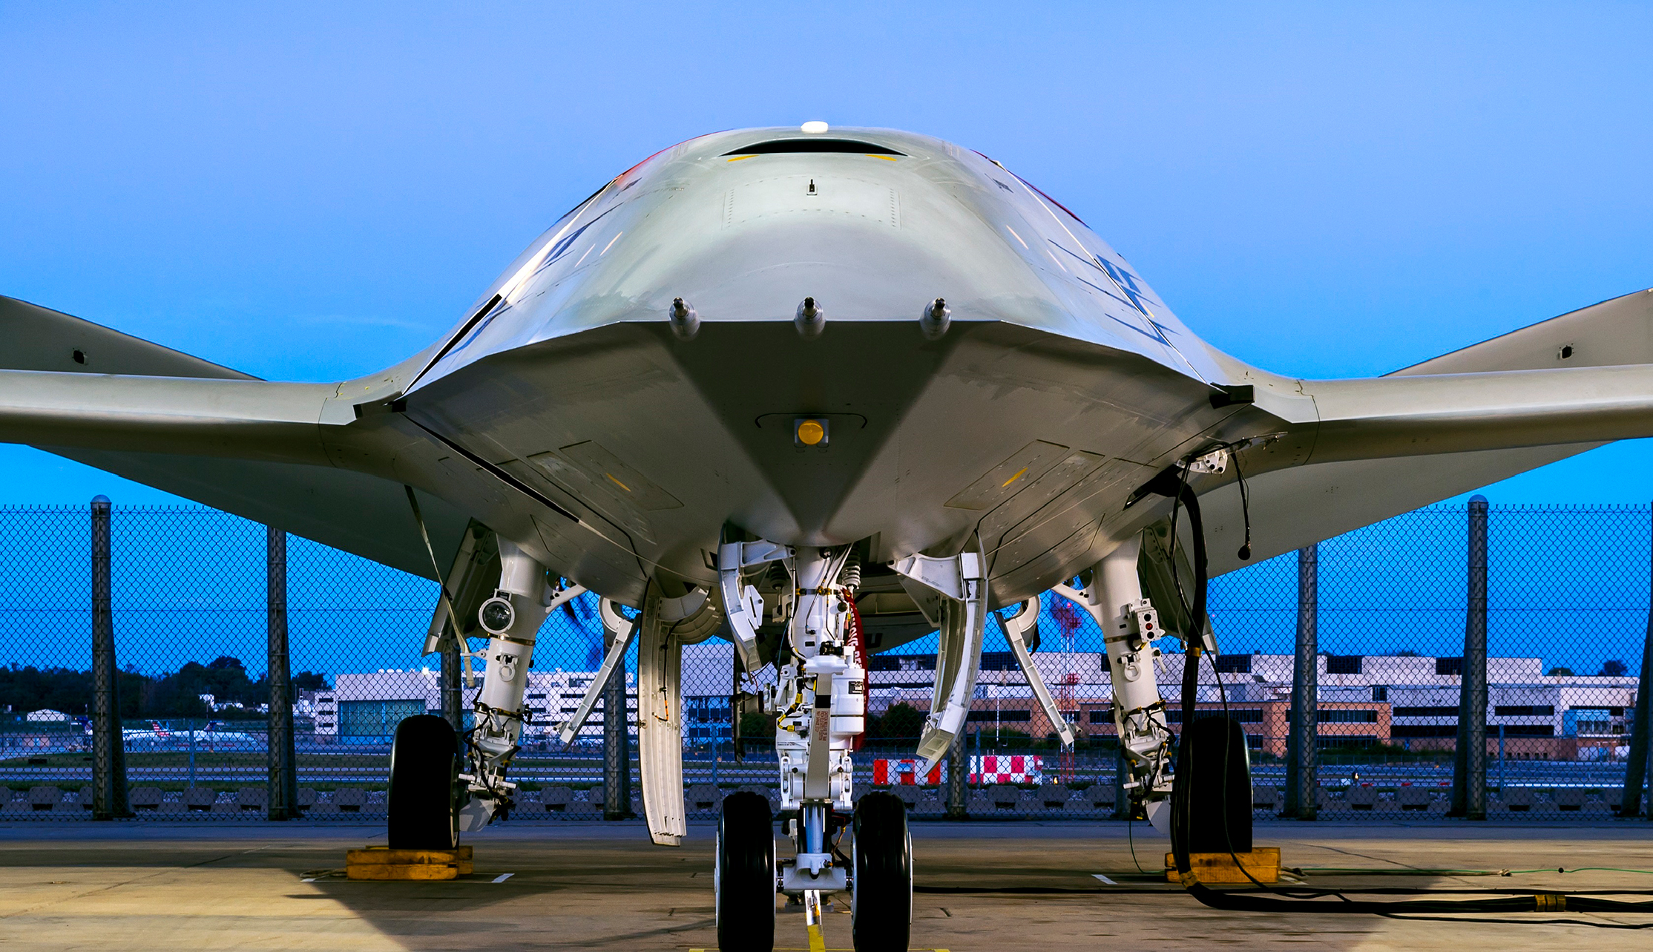
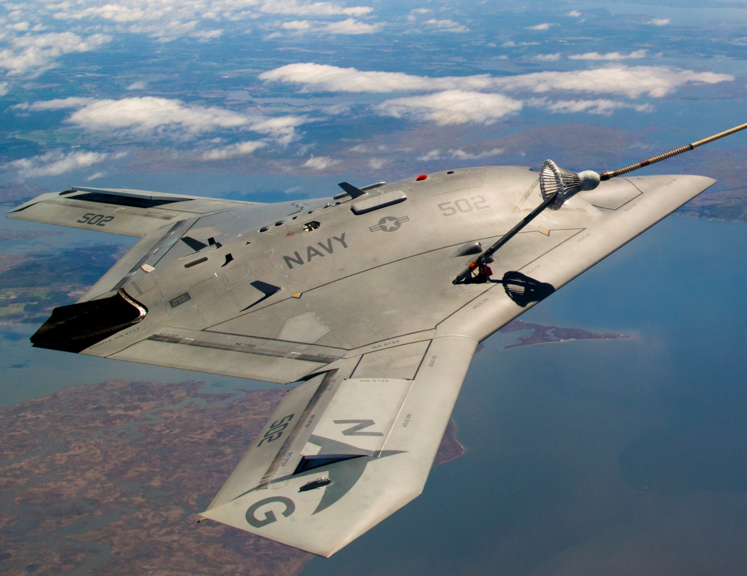
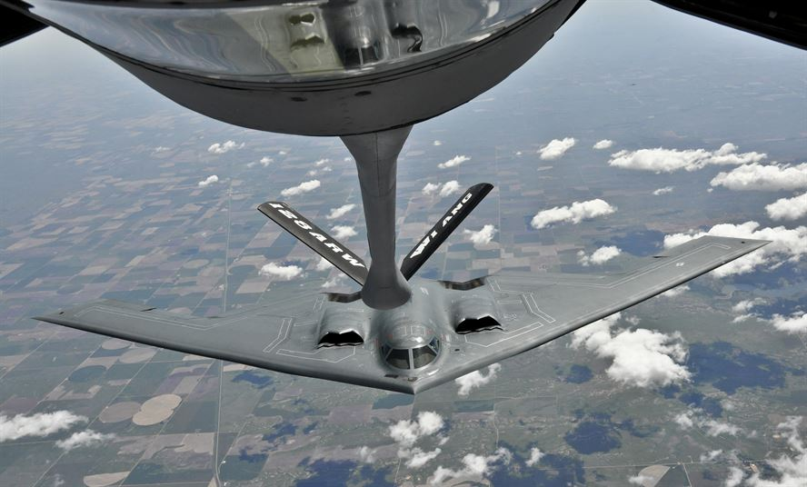
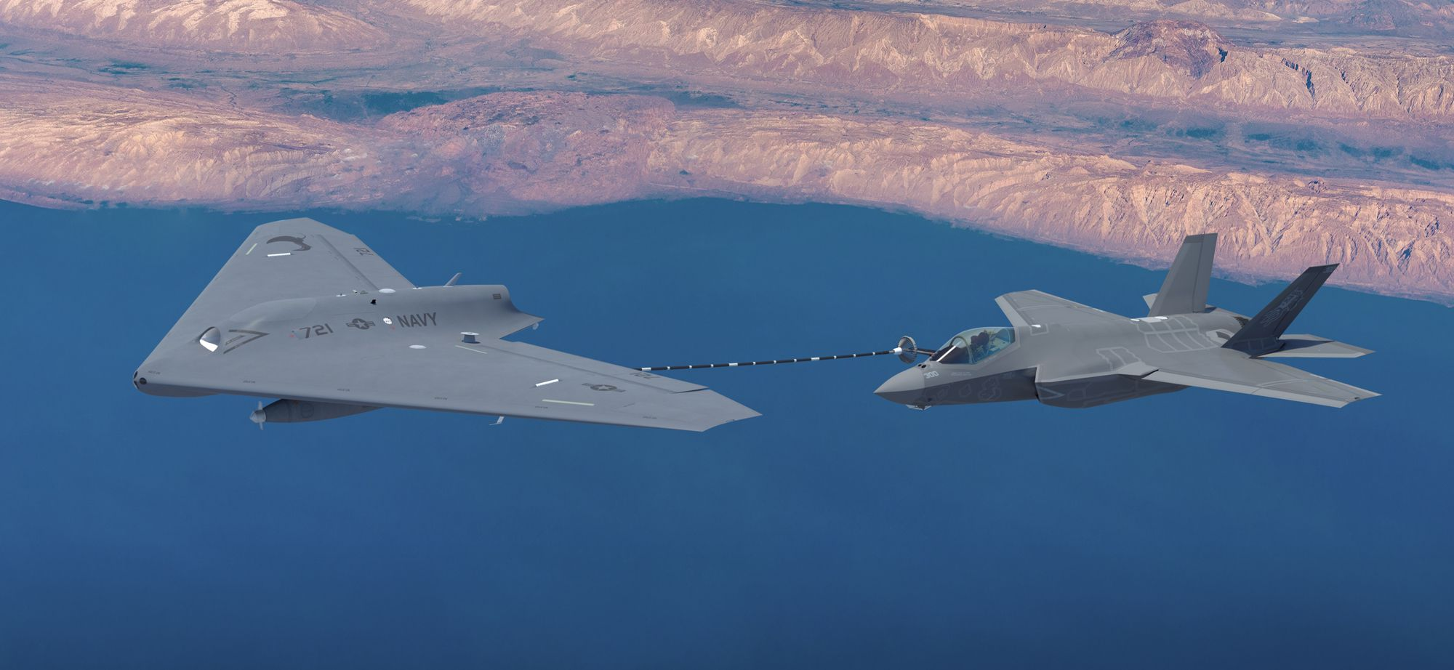
Aerial Refueling & Drones
(U.S. Air Force, 2018)
(Eckstein, 2017)
(Northrop Grumman, 2018)
(U.S. Air Force, 2018)
(Bennett, 2018)
Notes:
Applying Paradrogue Tech to UAVs, and increasing stability

Slide 4
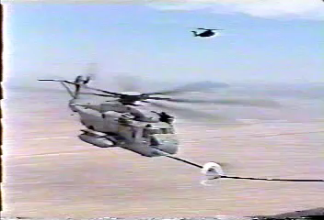
Increasing Stability
Notes:
Helicopter Video

Slide 5
Computational Fluid Dynamics
Pre-Processing
Solving
Post-Processing
Pointwise
Ansys Fluent
Fieldview

Slide 6

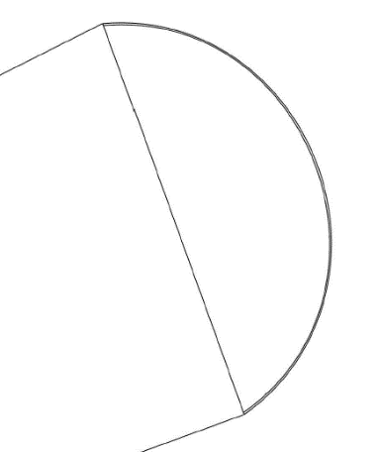
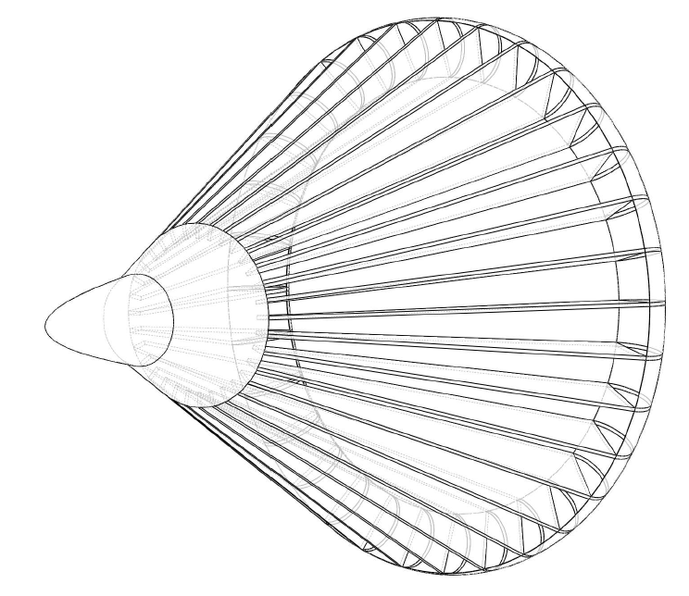
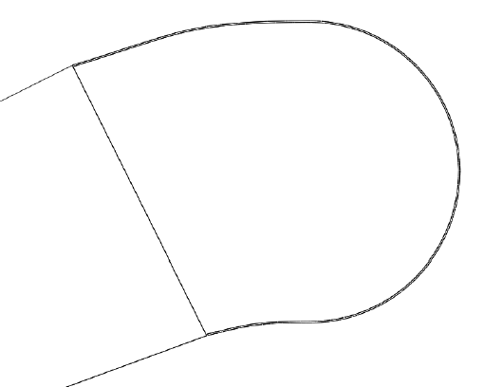
3D Models & Variations: Base Model & Chute Cross Section
Semicircle
Shallow
Deep

Slide 7
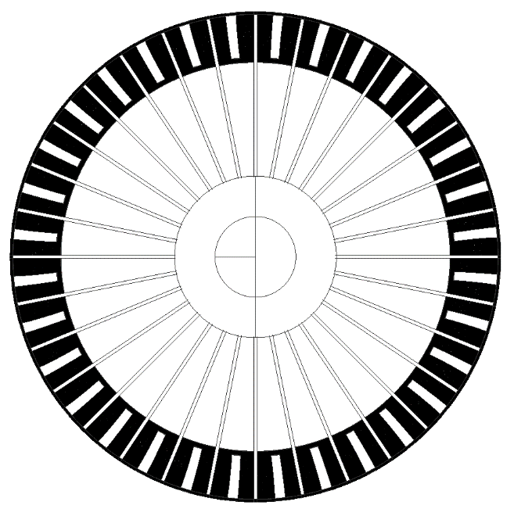
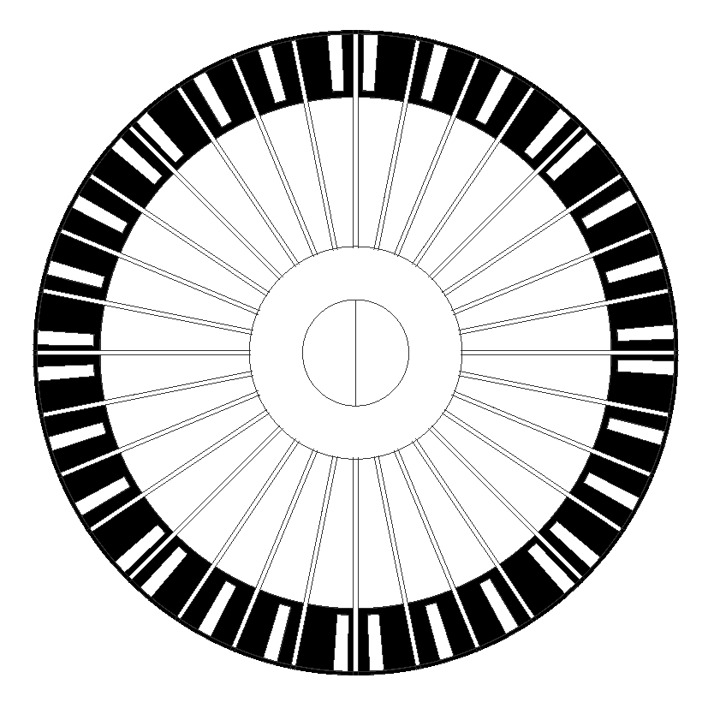

3D Models & Variations: Gore Spacing
Rectangular – Evenly Spaced
Rectangular – Unevenly Spaced
Stripes

Slide 8
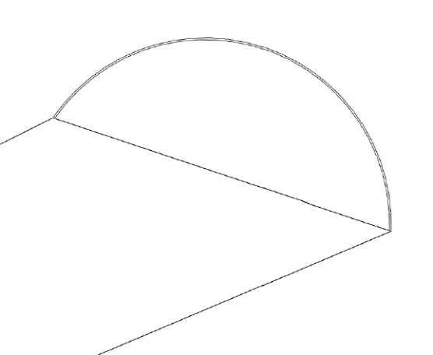
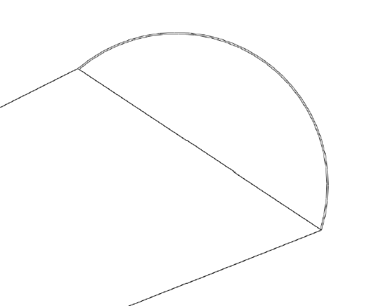
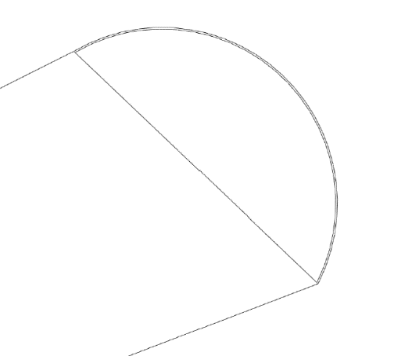
3D Models & Variations: Chute AOA
45 Degrees
60 Degrees
75 Degrees

Slide 9
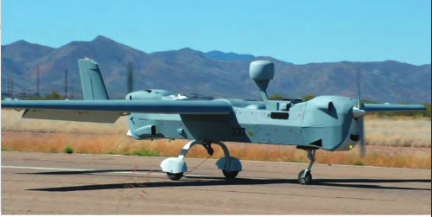
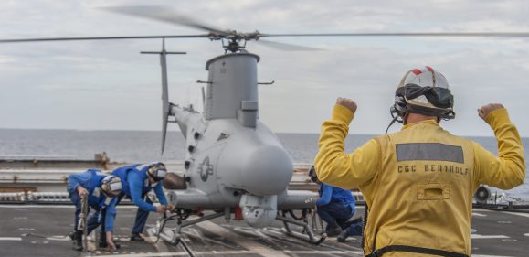
Paradrogue Simulation Conditions
(Northrop Grumman, 2018)
(Northrop Grumman, 2018)
MQ-5B Hunter
Flight Speeds: 60 – 120 knots
Wing Span: 34.25 ft
Endurance: 21 hours
MQ-8B Fire Scout
Flight Speeds: 85 knots
Rotor Diameter: 27.5 ft
Endurance: 595 nmi or 7.75 hours

Slide 11
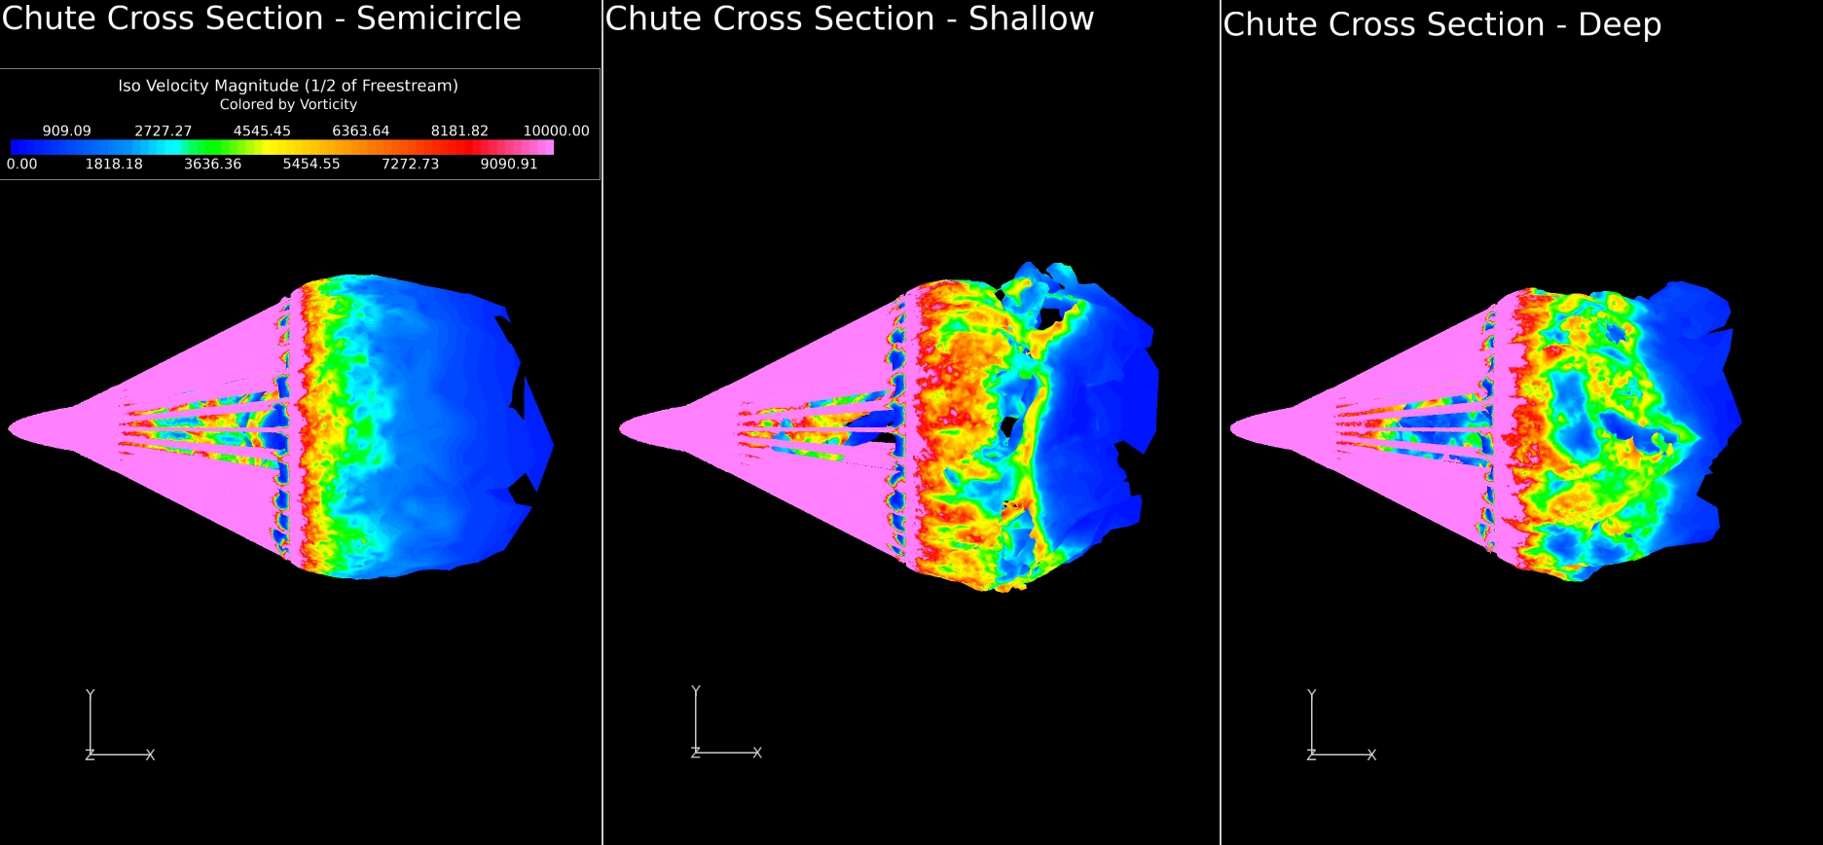
Simulation Results: Chute Cross Section

Slide 12
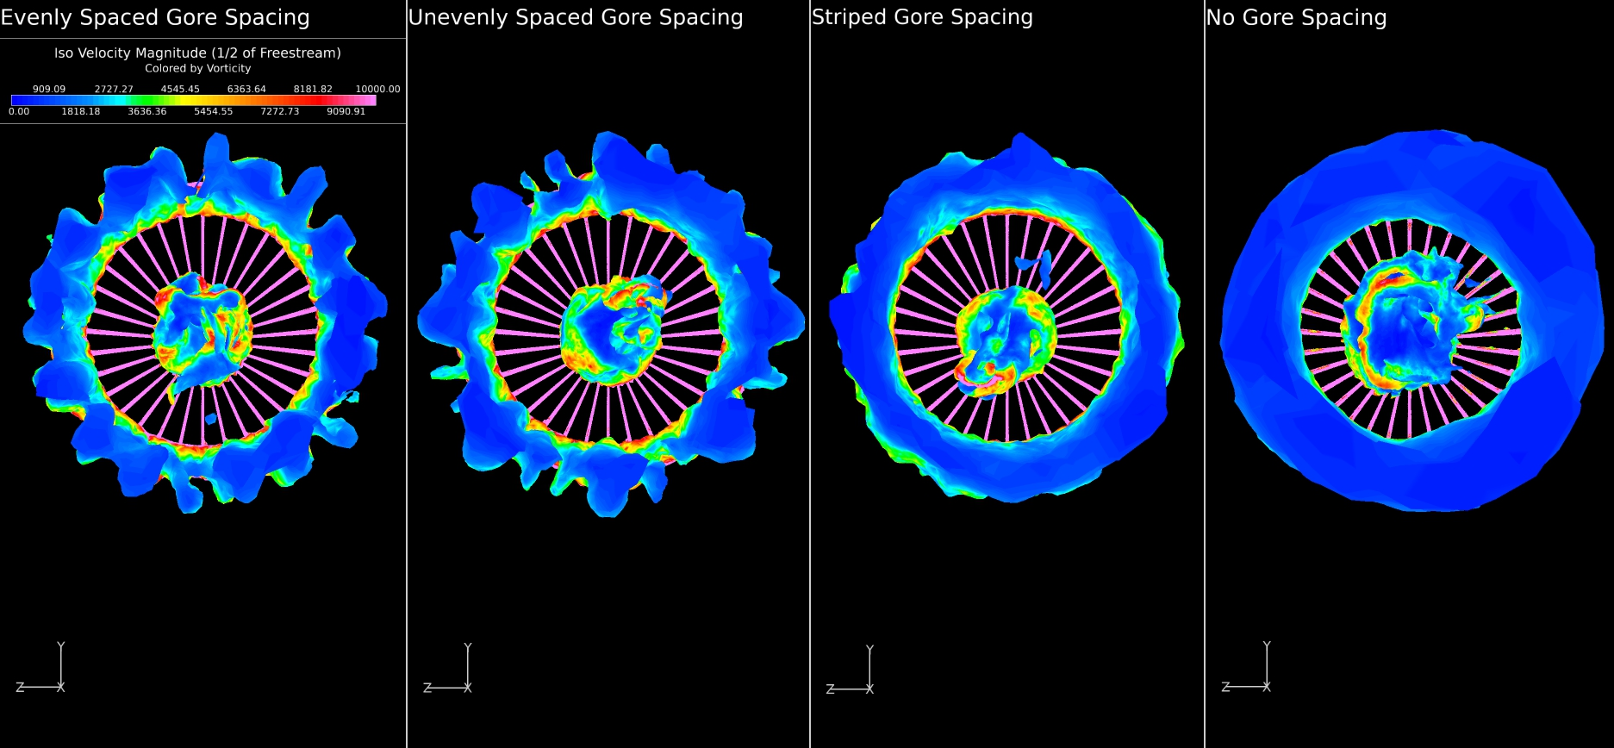
Simulation Results: Gore Spacing

Slide 13
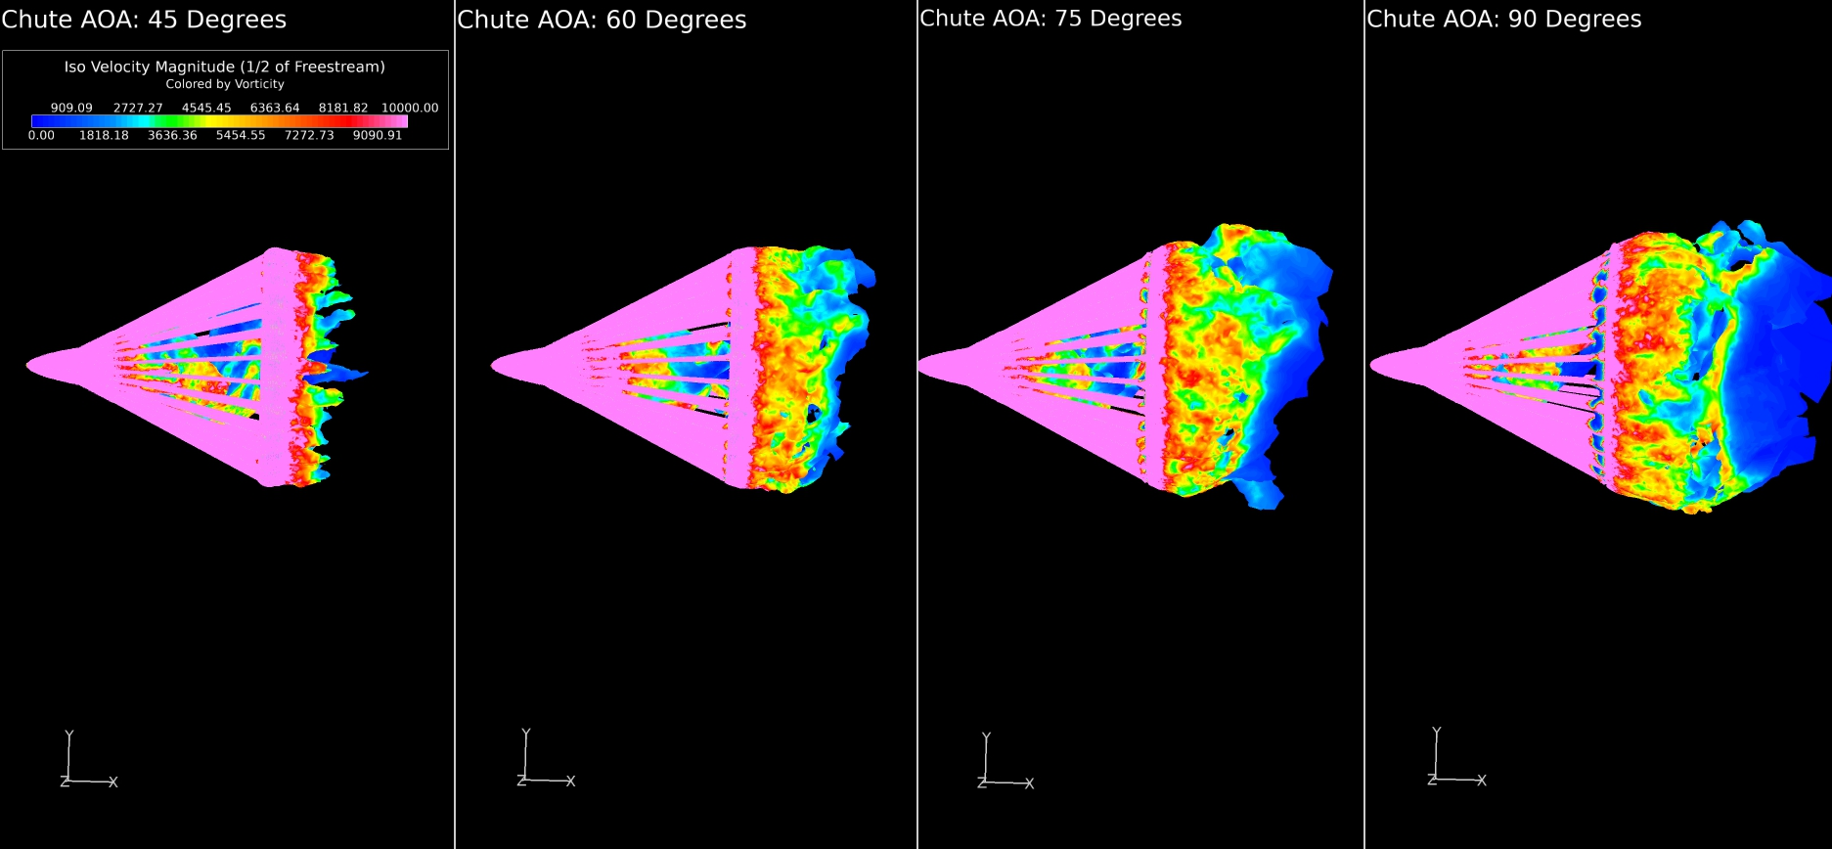
Simulation Results: Chute AOA

Slide 14
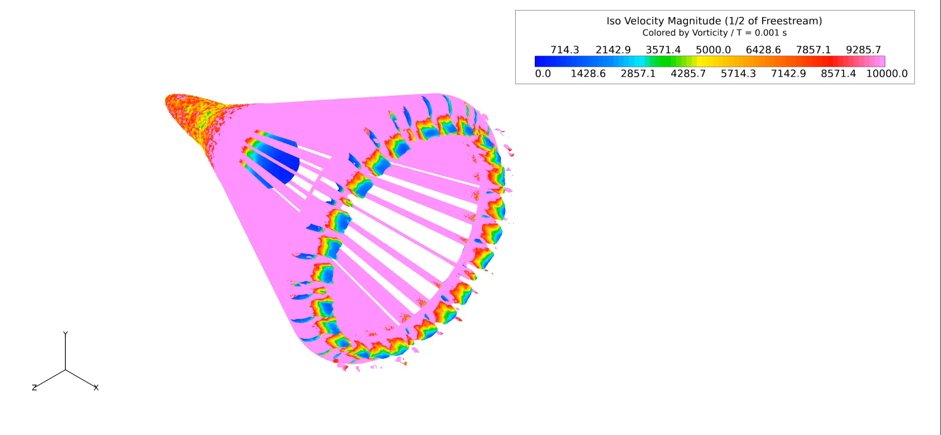
Transient Flow

Slide 15
Questions

